Slide 1


Foreign workers, local jobs & employer risk
Understanding South Africa’s
new labour landscape
Ofentse Davhie and Chris Hattingh
June 2026
Notes:
Front cover

Slide 2



Three levels of risk are firing at once
RISK LANDSCAPE
All three are live now. Only one of them is fixed by paperwork
National government
New law plus the political will to enforce it. 10,000 labour inspectors are being recruited this year, the binding constraint was always capacity, not statute.
Local & community
Anti-migrant mobilisation around the 30 June deadline. A known undocumented-labour site becomes a flashpoint.
Transnational & reputational
An employer named in a raid, especially one with a death, draws viral contagion faster than any court process. DIRCO is already briefing missions abroad.
Document compliance protects you against the state. It does nothing about the street, or the reputational contagion. The controls must cover all three.

Slide 3
The floor that already applies: Immigration Act
CURRENT LAW
Three things no employer may do, Bill or no Bill:
Employ an illegal foreigner
A foreigner in the Republic in contravention of the Immigration Act
Employ outside permitted status
A foreigner whose visa / permit does not authorise that employment
Employ off-permit terms
A foreigner on terms, conditions or in a capacity different from their status
The employer must make a good-faith effort to ascertain that no illegal foreigner is employed and to establish the status or citizenship of those it employs. Stricter compliance is expected of employers with more than five employees.

Slide 4
Why this matters: the law presumes you knew
CURRENT LAW
Under the Immigration Act, two presumptions operate against the employer. The burden is on you to rebut them.
Presumption of knowledge
If it is proven you employed someone unlawfully, you are presumed to have known their status
You escape only by proving good faith AND compliance with the verification duty
Presumption of employment
If an illegal foreigner is found on premises where a business operates, they are presumed to be employed by whoever controls the premises
Rebuttable only with prima facie evidence to the contrary
“I didn't know” is not a defence if you ought reasonably to have known the person's status. The duty is active verification, not passive ignorance.

Slide 5
Current penalties for knowingly employing an illegal foreigner
CURRENT LAW
Under the Immigration Act, penalties escalate with each conviction:
1st
conviction
Fine or imprisonment
not exceeding 1 year
2nd
conviction
Fine, or imprisonment
not exceeding 2 years
3rd +
conviction
Imprisonment up to 3 years
NO option of a fine
3rd +
conviction
Imprisonment up to 3 years
NO option of a fine
The third strike removes the fine option entirely. Repeat non-compliance becomes a custodial matter.

Slide 6
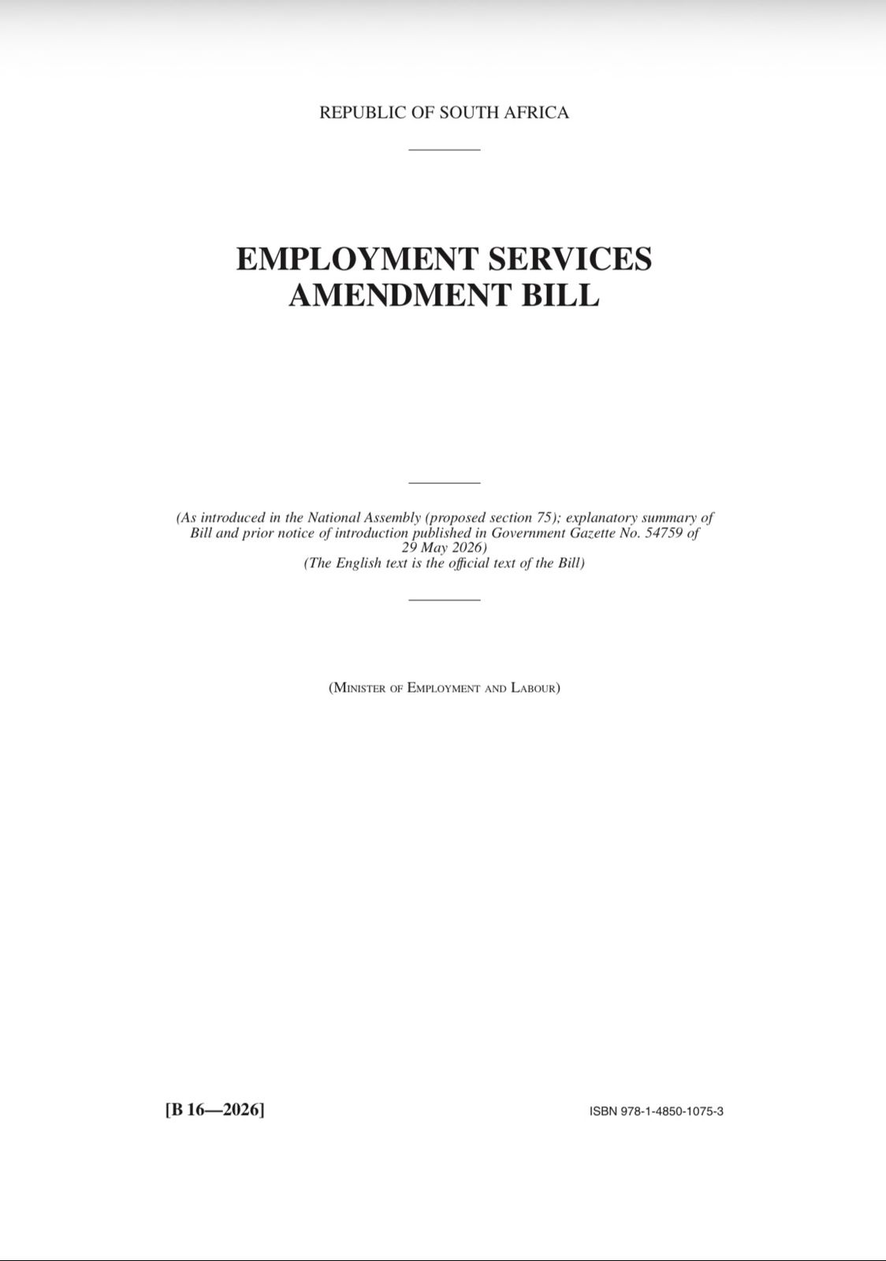
Employment Services Amendment Bill
Introduced in the National Assembly on 29 May 2026; still in the parliamentary process
Replaces the old foreign-worker rules with a new framework governing the employment of foreign nationals
Five duties before every hire: confirm the right to work; test the local labour market first; prepare a skills-transfer plan; offer equal terms; and keep copies of permits
Quota power: The Minister may set maximum quotas for foreign-national employment by sector, occupation or region (small employers under 10 excluded); the only relief is a formal exemption
Worker protections: A foreign national employed unlawfully keeps full enforcement rights; inspectors or bargaining-council agents may bring claims for them
Penalties, a graduated regime: Up to R100k (first offence), R200k (repeat within 3 years), and the greater of R1m or 10% of turnover for serial offenders
Definitional shift: “Foreign national” is redefined to exclude citizens, permanent residents, refugees and asylum seekers. Quotas bite on a narrower pool, and the recruitment-preference pool expressly includes refugees

Slide 7
The Bill's penalties: a steep, graduated regime
PROPOSED
A turnover-linked penalty is a competition-law instrument. Its arrival in employment law is the signal.
Non-compliance is no longer a fixed, budgetable cost. For a mid-sized manufacturer, 10% of turnover threatens solvency.
Courts must also strip any economic benefit gained, closing the “pay the fine and carry on” loophole.

Slide 8
Injury or death on site, with invalid documentation
A foreign national is injured or killed on site. Their papers turn out invalid, expired or fraudulent. “They weren’t legally our employee” is not a defence. It makes the position worse.
Workplace safety & injury cover
The duty to provide a safe workplace is owed to everyone on site; status is irrelevant. The courts have treated undocumented workers as employees for injury-compensation purposes.
Immigration crime
Criminal liability for employing the worker without valid papers, under the Immigration Act.
Civil fine
The new escalating fine regime under the amended Employment Services Act applies on top.
Reputation
A worksite death involving an undocumented worker, in this political climate, travels fast and wide.

Slide 9
Verification & due diligence: what to check before hiring
Grounded in the existing verification duty and the Bill’s proposed new duties. A valid-looking visa is not the end of the check.
1
2
Authenticity & type
Confirm it is genuine, not forged, and authorises this work
Employer alignment
Many permits are tied to a named employer, confirm it is you
3
4
Occupation match
The work performed must match the role the permit authorises
Expiry & conditions
Check the expiry date and every condition attached to the permit
5
6
Records retention
Keep records; the rules require two years after the worker leaves
Ongoing monitoring
Re-verify on promotion, role change or transfer between entities

Slide 10
Coordinated enforcement push
The Bill is the legislative arm of a politically driven campaign; not a regulatory footnote.
What we expect
A tenfold rise in inspection capacity, plus penalties built to make repeat non-compliance unaffordable
Enforcement is already happening ahead of the Bill: arrests in Tshwane, Newcastle and Mossel Bay
Most likely path: it becomes law broadly as drafted; quotas land first in high-foreign-employment sectors; enforcement intensifies, not fades
10 000
new labour inspectors being recruited this financial year
The constraint was never the law. It was capacity. That is changing, permanently.

Slide 11

Stay ahead of the risks that move markets
Premium Clients enjoy access to
Strategic Intelligence Briefings: Expert-led sessions tailored to your sector's risk landscape
Strategic Intelligence Reports: In-depth analysis on geopolitical, economic and policy shifts
Weekly Risk Alert: Never be blindsided by fast-moving developments
Data queries & research support: Your team, backed by ours
Client Notes & Socio-Economic Survey of South Africa: The context behind the headlines
❯ Book a briefing or schedule a call today
ofentse@cra-sa.com
Understand. Prepare. Prosper.
Notes:
Back cover

